Slide 1
DS 501- Case Study -1
By
Farah, Satish and Mohmad

Slide 2


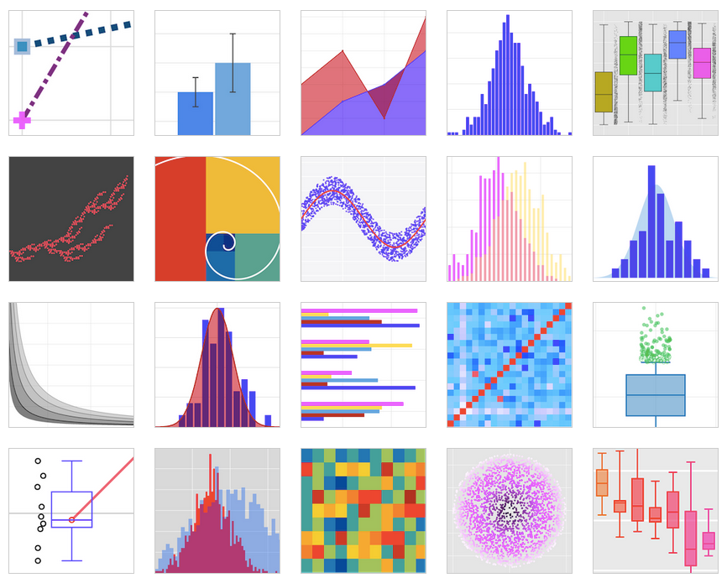




Relax, Nothing is under control !

Slide 3
Many ideas, late night hangouts, weekend meetings
Retail:Target VS Walmart Healthcare
#Elections #NFL Nike VS Adidas
Traveling #Food Coffee shops:Starbucks VS Dunkin Donuts
#Diabetes #Oscars

Slide 4
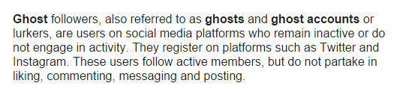
The Big Idea:
Find ghost accounts on Twitter
https://en.wikipedia.org/wiki/Ghost_followers

Slide 5
And …….

Slide 6

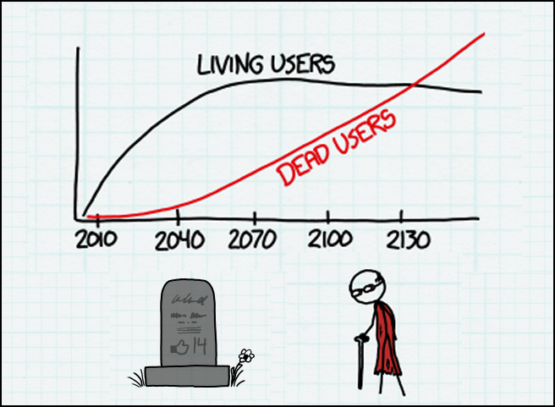
Deviated from finding ghost account to finding suspected dead users

Slide 7
Constraints..
Twitter’s time window which is 7 days
Private VS Public Accounts data and Geo Location was disabled in many cases
So we were searching for keywords like;
RIP
R.I.P
Condolences
Rest In Peace

Slide 8
Excerpt from the code to report statistics about the data..
print "Total Tweet Count : "+str(total_tweets) print "***** PRINTING TOP 30 WORD COUNT *****" DataSet = jsonto_PandaDataFrame(total_words) display(DataSet.head(30)) print "***** PRINTING TOP 10 HASHTAG COUNT *****" DataSet = jsonto_PandaDataFrame(total_ht) display(DataSet.head(10)) print "***** PRINTING TOP 10 SCREEN NAMES COUNT *****" DataSet = jsonto_PandaDataFrame(total_sn) display(DataSet.head(10))
Analysing Data from File - condolence.json Analysing Data from File - R_I_P.json Analysing Data from File - RIP.json Analysing Data from File - restInPeace.json Total Tweet Count : 360011

Slide 9
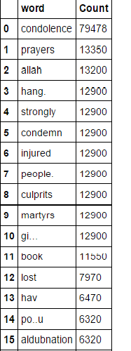
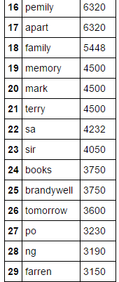
***** PRINTING TOP 30 WORD COUNT *****

Slide 10
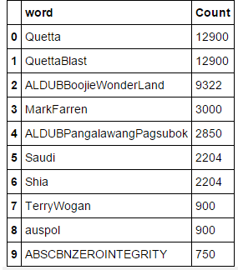
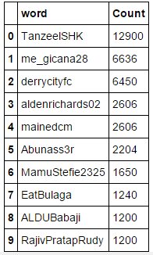
*** PRINTING TOP 10 HASHTAG COUNT ***
***PRINTING TOP 10 SCREEN NAMES COUNT **

Slide 11
Now finding the most popular tweets in the domain or our main idea:
***** PRINTING TOP 10 popular Tweet *****
Analysing Data from File - condolence.json Total Tweets - 90010 Analysing Data from File - R_I_P.json Total Tweets - 90000 Analysing Data from File - RIP.json Total Tweets - 90001 Analysing Data from File - restInPeace.json Total Tweets - 90000

Slide 12
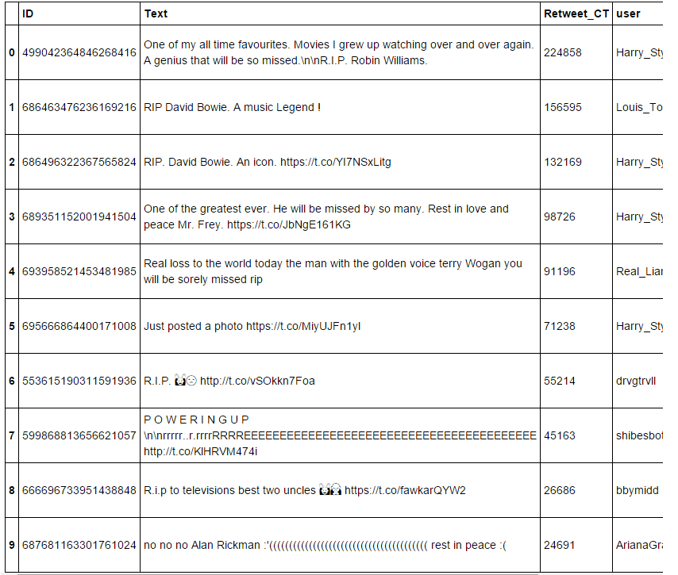
Now back to Case Study: Answering Problem -3 **PRINTING TOP 10 popular Tweet in Tabular Form**

Slide 13
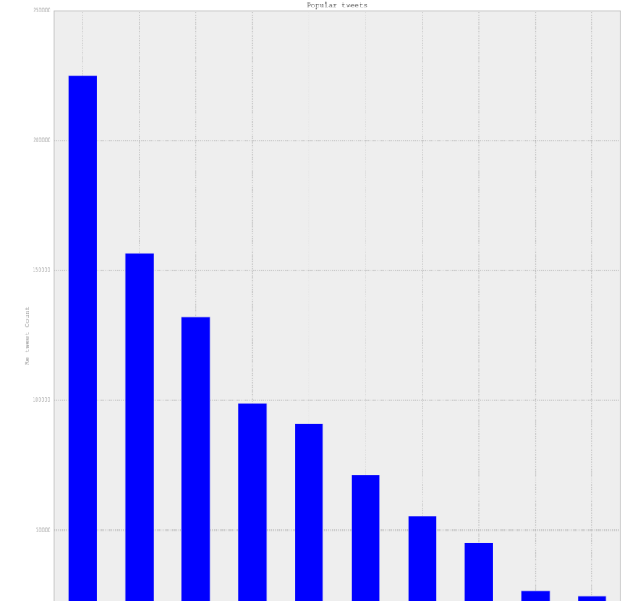
Problem 3 continues: Histogram representing top 10 most popular tweets:

Slide 14
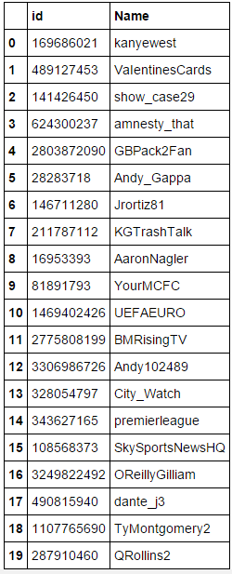
Playing around with data to answer Questions like:
#3. Find the most popular Tweet Entities in your collection of tweets #(1) plot a table of the top 10 hashtags, #(2) top 10 user mentions that are the most popular in your collection of tweets.
Total Friends Count 449
Plot 20 Friends

Slide 15
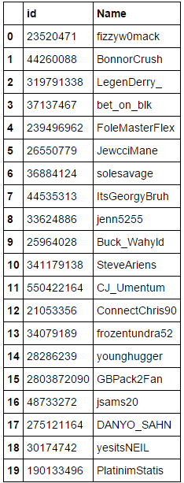
And our search continues to answer the rest of the questions!!!!!!
***** Plot 20 Mutual *****
***** Total Mutual Count 292 *****

Slide 16
The novelty …...

Slide 17
Processing Tweets Results
Searching for:
Before Checking Last Activity of suspected dead account:
Number of unique accounts suspected dead = 743
Number of unique accounts suspected lost someone = 2524
Before Checking Last Activity of suspected dead account:
Number of unique accounts suspected dead = 3207
Number of unique accounts suspected lost someone = 35
Number of private accounts from suspected dead list = 14

Slide 18

Processing Tweets To Find Dead Accounts
Searching for:
Unique @Mentioned Names
Unique tweet originated screen names
Unique in_repy_to_screen_name
Why these names?
Why in_repy_to_screen_name?

Slide 19
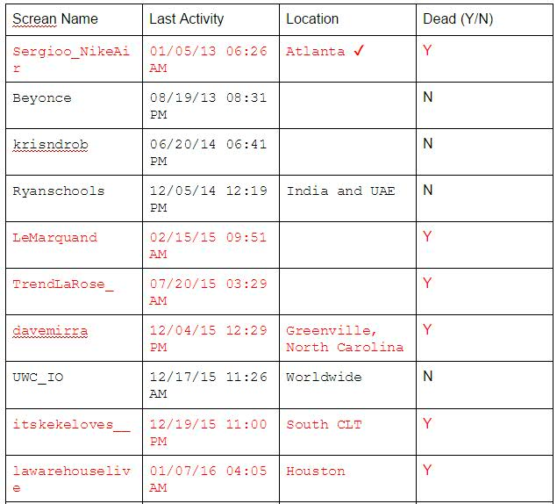
Checking Suspect's Timeline
*Number of people actually dead = 6
*Number of people lose someone = 3236
*Notice last activity
*All in US
*Why lost someone way bigger?
*Who died impact the social media?
*How someone die impact the social media?

Slide 20


